Slide 1



NAME OF THE PROJECT:
To develop a CNN model to classify images of plastic waste

Slide 2

LEARNING OBJECTIVES:
1. Understand the need for plastic waste classification
2. Learn how CNNs help in image classification.
3. Preprocess and prepare data for training.
4. Build and train a CNN model using Python.
5. Evaluate model accuracy and performance.
GOAL
Source :
www.freepik.com/

Slide 3
TOOLS AND TECHNOLOGY USED:
Programming Language: Python.
Development Environment: VS Code & Google Colab.
Frameworks & Libraries: TensorFlow, Keras, NumPy, Pandas, Matplotlib.
Dataset Handling: OpenCV, PIL.
Operating System: Kali Linux & Windows.

Slide 4
METHODOLOGY:
Dataset Download – Downloaded a pre-existing dataset of plastic waste images.
Data Preprocessing – Resized, normalized, and augmented images for better model performance.
Model Development – Built a CNN architecture using TensorFlow/Keras.
Training & Testing – Trained the model with labeled data and evaluated its accuracy.
Performance Analysis – Measured accuracy, loss, and optimized the model.

Slide 5
PROBLEM STATEMENT:
1. Plastic waste pollution is a serious environmental problem, causing harm to land and water. Sorting plastic waste manually is slow, labor-intensive, and prone to mistakes.
2. This project aims to create a CNN-based model that automatically classifies plastic waste from images, improving sorting speed and accuracy, and helping in better recycling and reducing pollution.

Slide 6
SOLUTION:
1. We developed a CNN model to automatically classify plastic waste from images. By training the model with a dataset of plastic waste images, it learns to identify different types of plastic.
2. This system speeds up waste sorting, improves accuracy, and supports better recycling, helping reduce environmental impact.

Slide 7
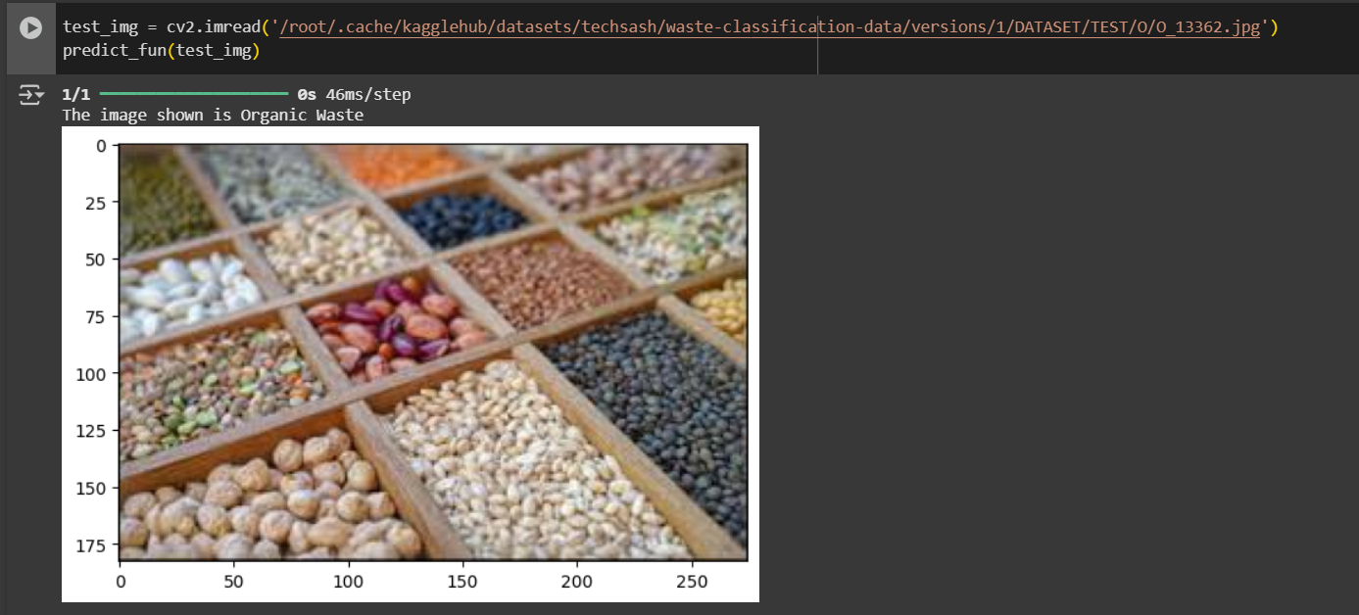
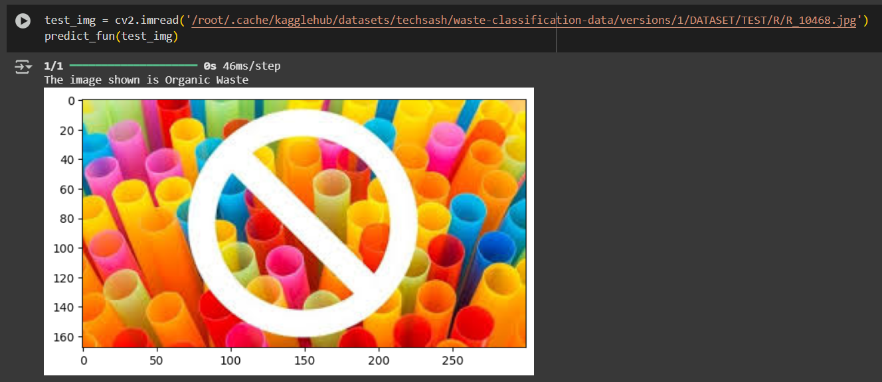
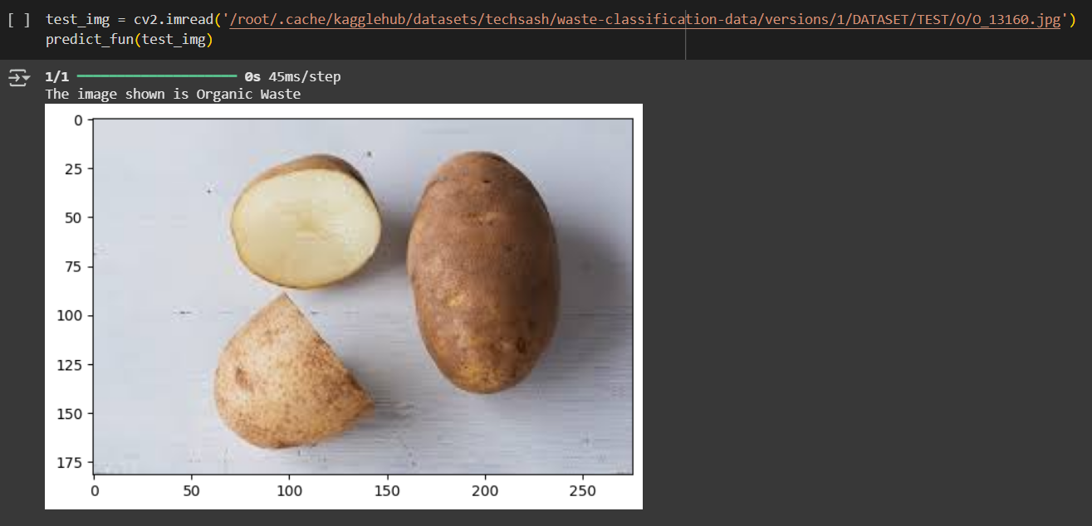
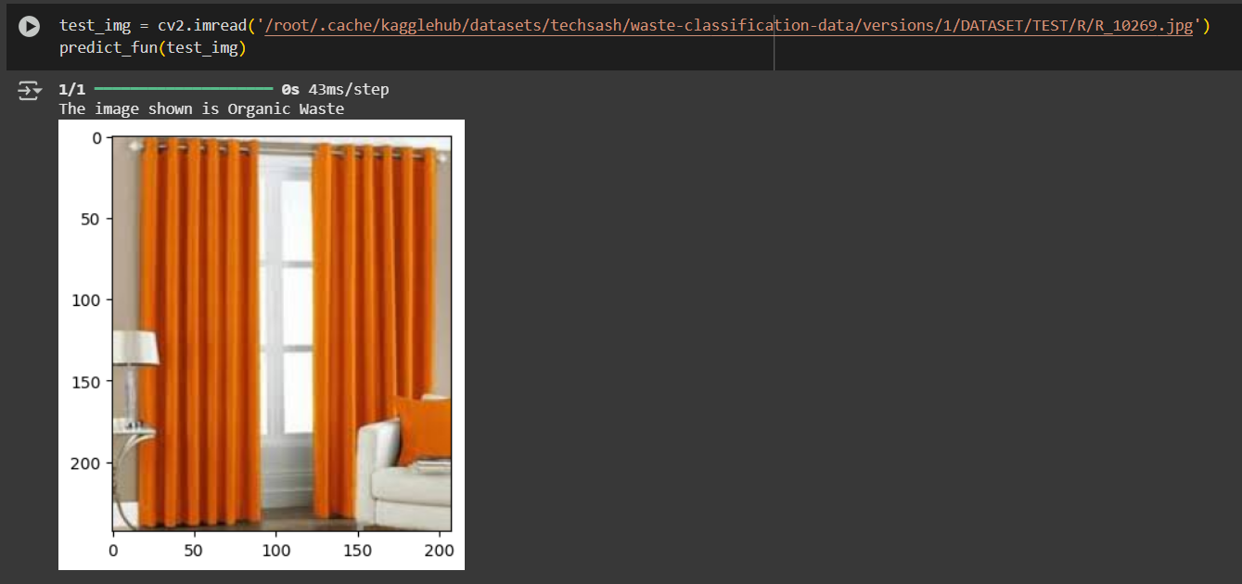
SCREENSHOT OF THE OUTPUT:

Slide 8
CONCLUSION:
1. This project demonstrates the potential of Convolutional Neural Networks (CNNs) in automating the classification of plastic waste. By using deep learning, we can significantly improve the speed and accuracy of waste sorting, enhancing recycling processes.
2. The model can be further optimized and deployed for real-world use, contributing to more efficient waste management systems and supporting environmental sustainability by reducing plastic pollution.
THANKING YOU…

